Slide 1
On the (un)usefulness of econometrics for RTD policy impact assessment: Dutch experiences
Outline
The Dutch policy impact assessment strategy: how do we do it?
Using RCT’s, natural experiments and advanced econometrics: a quick review
Beyond econometrics: a bird’s eye view
Observations & conclusions
Dr. Theo Roelandt
Chief Analyst
DG Enterprise & Innovation
Ministry of Economic Affairs & Climate Policies
September 3th 2021
RTD policy evaluations workshop “Veranstaltung zu ökonometrie in de Evaluierung: Was können ökonometrische methode – was könne sie nicht?”
Austria Platform for R&T Policy Evaluation
“Heroic policy making:
To live in a modern democracy is to be experimented on by policymakers from cradle to grave. Education is intended to mould an upstanding future citizen; a prison sentence, reshape someone who has gone astray. But without evidence, those setting policy for schools and prisons are little better than a doctor relying on leeches and bloodletting. Citizens, as much as patients, deserve to know that treatments they endure do actually work”.
(“In praise of human guinea pigs”, The Economist, December 12th, 2015, p. 18)

Slide 2
Our Policy Impact Assessment Strategy
Developing a consistent Policy Intervention Theory.
Monitoring key performance indicators (macro, policy areas, sectors, institutions & interventions).
Evaluating policy instruments using state of the art (econometric) methodologies and data : ex post, ex ante and small scale policy experimentation, counterfactual & control groups, natural experiments using econometrics.
Investing in creating high quality (linked) micro-data sets and methodologies that can reveal causality.

Slide 3
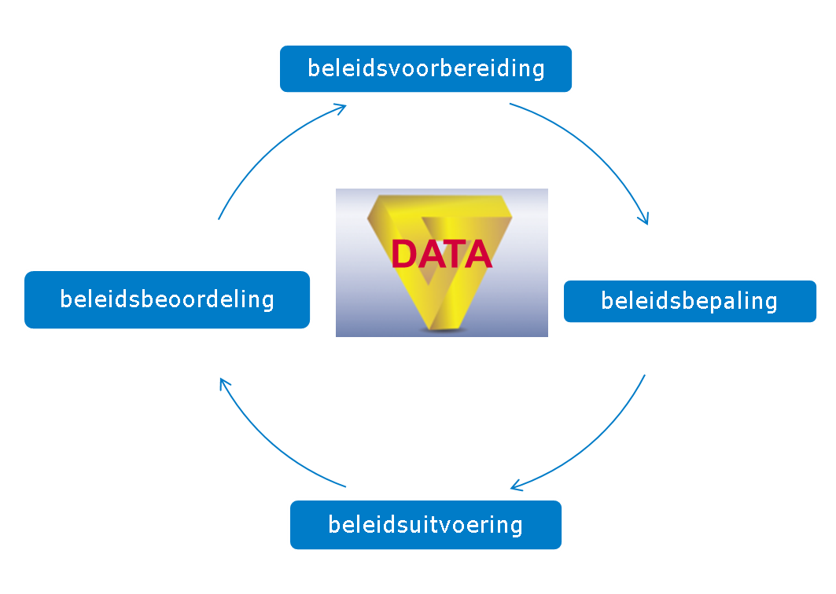
Around the policy circle: data & analytics
Policy statistics & indicators
policy preparation
Data-analyses
Expost evaluatie &
natural experiments
Exante evaluation &
Social experiments
CBS
RvO
policy evaluation
policy design
BAT
Key Performance Indicators,
Zero point measurement &
Data-development
data-assessments
policy implementation
Monitoring & policy progress assessment

Slide 4
How do we do it?
1st best: social experiments using randomised control trails and difference-in-means estimates (ex ante evaluation), including “nudging”
2nd best: natural experiments using econometrics on (linked) micro-data (ex post evaluation):
“regression discontinuity”, “difference-in-difference”, “propensity score matching”
3th best: advanced econometrics (no control group)
4th best: descriptive statistics and perceptions
In all cases: combining quantitative and qualitative methodologies and data
Evaluation Quality = methodology * data²

Slide 5
Some RTD-examples of what it delivers
RCT: short & long term impact innovation vouchers scheme
Natural experiments:
- Innovation Credit
- Innovation Box (profit based tax credit)
- Applied Research Organisations
- Eurostars
- Technology Foundations
- SBIR
- WBSO (labour based tax credits)

Slide 6
Randomised Controlled Trials
Scheme / estimation period | Aim | Methodology | Results
Innovation vouchers, 2004-2005 Innovation vouchers, 2002-2017 SME Innovation Stimulation Scheme Topsectors (MIT), consisting of various subschemes; 2012-2015 | More utilisation by SMEs of research performed by public knowledge institutes More utilisation by SMEs of research performed by public knowledge institutes More research and innovation in SMEs, particularly in the context of the top sector approach | - Estimation method: analysis of survey results on the basis of a linear probability model - Control group: non-selected applicants in a lottery procedure in 2004 (first round of allocation of innovation vouchers) - Estimation method: panel analysis (fixed effects included in robustness analysis) - Control group: non-selected applicants in lottery procedures during the years 2004-2005 - Estimation method: fixed effects panel analysis, reflecting a difference-in-difference approach - Control group: non-selected applicants in lottery procedures during the years 2013-2015 | Positive effect on projects assigned to public knowledge institute. [Out of every ten vouchers, eight were used for a project that would not have been assigned to a knowledge institute, one was used for a project that would have been assigned anyhow, and one voucher was not used.] Positive effects in the short, medium and long tem on employment and the survival probability and in the long term also a positive effect on business R&D. No effect found on labour productivity. Positive effects on business R&D. Effects on business performance not estimated.

Slide 7
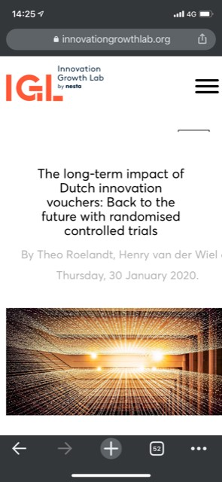

Slide 8
Natural experiments (I)
Scheme and estimation period | Aim | Methodology | Results
Experimental design: whether or not a grant/credit has been obtained Innovation credit, 2006-2016 Dutch participation in Eurostars, 2008-2019 Innovation box, 2008-2013 | More high-risk development projects, aimed at new products and processes More R&D and innovation, particularly in SMEs More business R&D and innovation and a better investment climate for R&D related business activity | - Estimation method: fixed effects panel analysis, reflecting a difference-in-difference approach. - Control groups: 1) rejected applicants and 2) as non-applicants a selection of WBSO users with on average similar characteristics as the treatment group of approved applicants - Estimation methods: difference-in difference and regression discontinity design (in the latter case: project review score as control variable) - Control groups: 1) rejected applicants and 2) selection of WBSO users based on propensity score matching - Estimation method:difference-in-difference and, as related approach, first difference. - Control group: WBSO users that did not use the Innovation box | Positive effects on business R&D and business performance (particularly employment and survival probability; mixed results for effects on turnover) - Positive effect on business R&D - No effect found on business performance (turnover, employment and labour productivity) Positive effect on business R&D (BFTB: 0.54). No significant effect on innovation perfomance, measured as turnover share of new and improved products. Effects on further business performance (e.g. turnover, employment) not estimated

Slide 9
Natural experiments (II)
Scheme and estimation period | Aim | Methodology | Results
Experimental design: whether or not a grant/credit has been obtained Applied research organisations TO2: co-operation in R&D and innovation with firms, 2008-2018 Small Business Innovation Research (SBIR), 2007-2015 Technology Foundation STW, 1996-2011 | More innovation More innovation, particularly in SMEs More technical research in public institutes, to be utilised by firms | - Estimation method: fixed effects panel analysis, reflecting difference-in difference - Control groups: 1) WBSO users in general and 2) WBSO users based on propensity score matching - Estimation methods: difference-in difference and regression discontinity design (in the latter case: project review score as control variable) - Control groups: 1) WBSO-users that did not apply for SBIR and 2) rejected applicants - Estimation methods: difference-in-difference, regression discontinuity design and ‘fixed effects’/’random effects’ panel analysis (project review scores as control variable in case of regression discontinuity design) - Control group: rejected applicants | Positive effects on business performance (value added and employment) and also on business R&D - Mixed results for effects on business performance (turnover and employment) - Virtually no effect on business R&D Positive effects on publication performance of researchers, measured by the number of publications and the number of public-private co-publications Mixed results for effect on patent appllications

Slide 10
Natural experiments (III)
Scheme and estimation period | Aim | Methodolgy | Results
Experimental design: impacts of policy developments vary among groups of firms, dependent on firm characteristics WBSO (R&D tax scheme), crisis measures, 2007-2010 WBSO (R&D tax scheme), introduction of starters facility and extension of the first bracket of R&D expenditure, in which the tax credit rate is relatively high, 1994-2003 | Mitigating the effect of the economic crisis on business R&D More business R&D | - Difference-in-difference - Control treatment groups: different groups of WBSO users - Difference-in-difference and, as related approach, first difference - Control and treatment groups: different groups of WBSO users | Positive effects on business R&D Positive effects on business R&D
Traditional regressions: advanced econometrics
Scheme and estimation period | Aim | Method | Results
WBSO (R&D tax scheme), 2011-2017 | More business R&D | Estimation method: fixed effects panel analysis, including instrumental variables in order to control for dependence of the WBSO tax credit rate on the amount of R&D expenditure (‘synthetic user cost of R&D’ approach) Sample: WBSO users; no control group | Positive effects on business R&D; BFTB on R&D wage expenditure: 0,90 (effect on total R&D expenditure not estimated because of data limitations) Furthermore: positive effects of business R&D on innovation performance (turnover share of new and improved products) and business performance (labour productivity)

Slide 11
The (un)usefulness of econometrics in policy evaluation
Very usefull indeed:
more inside in what works and what doesn’t in “single agent policy instruments” (one actor, one measurable target, financial of character).
Provides hard evidence on policy impact: additionality, effectiveness & “bang for the buck”. Depoliticise the policy debate with facts. More “bang for the buck” from tax payers’ money.
It encouraged to make more work of data-development and policy monitoring, right from the start of new policy initiatives.
But not in all cases:
Most modern policies are more than “single agent” instruments (transformative, systematic, multi-actors, complex policy mixes and interactions): econometrics doesn’t help much
E.g. mission oriented innovation policy, industry carbon reduction policies, digitalisation policies.
Call for new methods and data and “theory of change-methodologies”.

Slide 12
Evaluation: complexity, policy interventions & the use of econometrics
high
Complexity (actors, factors & dynamics)
Usefulness of econometrics
low
Type of policy interventions
Tax incentives <> Business R&D-grants <> Collaborative R&D <> Ecosystem/Cluster <> Policy Mix <> System & Transiton Policies
Notes:
Henry

Slide 13
A new evaluation framework for systemic & transformative policies?
Internationally, evaluation techniques still in its infancy. No Gold Standard available.
Therefore, Dialogic i.c.w. Harvard Kennedy School for Public Policy developed a new framework
See Janssen (2016): What bangs for your bucks?, CID-paper no 69.
Transformative policies like TSA are about adapting socio-economic systems to open opportunities for a set of new technologies
The framework assesses how much policy contributed to changes or transitions in these technological innovations systems (TIS)

Slide 14
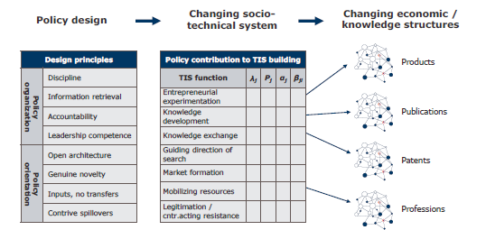
Systemic Evaluation Framework: bird’s eye view
Highlights
• Transformative policy is selective, process-oriented and multi-instrumental.
• We develop a framework for assessing transformative policy design and impact.
• We apply the framework to evaluate the Dutch Topsector approach.
• The Topsector approach adheres to many of the design principles for transformative policy.
• Impact mostly consists of engaging private parties in fortifying existing knowledge networks.

Slide 15
It delivers another kind of insight on policy impact
TSA seems to be effective (i.e. more public private partnership) and efficient (i.e. social benefits > social costs)
TSA improved the innovation system
Observations/dilemma’s
Structural changes take time to occur
Differences between top sectors depending on state of technology and quality of the innovation system
Bottom up versus top down => role of government in setting goals?
Improvements in policy design of TSA => next phase more focus on societal challenges and goals

Slide 16
Wrapping up & discussion
$Evaluation Quality=methodology ∗ {data}^{2}$
Econometrics helps policy makers to know the causal impact for “single agent instruments” and it helps increasing the quality and impact of public expenditures.
Transformative & systemic policies and complex policy mixes demand for new methodologies. Internationally still in its infancy.
In the Netherlands: a new “evaluation experts committee” installed developing new methodologies, next to the econometric tool box available. Will bring its advice in the Summer 2021.
“Don’t trow out the baby with the bathwater!”: use econometrics where it can and is usefull, but develop and adopt at the same time new methodologies for transformative and systemic policy mixes. Combine quantitative & qualitative methodologies.

