Slide 1

Nicht-experimentelle Methoden zur Kausalanalyse:
Am Beispiel der
Evaluierung öffentlicher Gründungsförderung
Hanna Hottenrott – Technische Universität München
FT Eval Veranstaltung: "Was können ökonometrische Methoden, was können sie nicht?„
Österreichisches Institut für Wirtschaftsforschung
3. September 2021

Slide 2







Start-up subsidies?

Slide 3
The main research question
Do subsidies help startups to perform better?

Slide 4
Example: Employment growth
(2008 cohort)

Slide 5

The evaluation question
How would a start-up have performed in absence of the subsidy?
Answer:
We will never know.

Slide 6
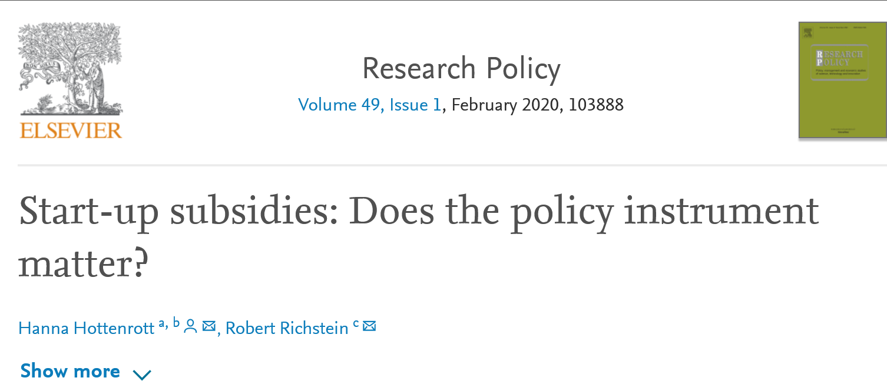
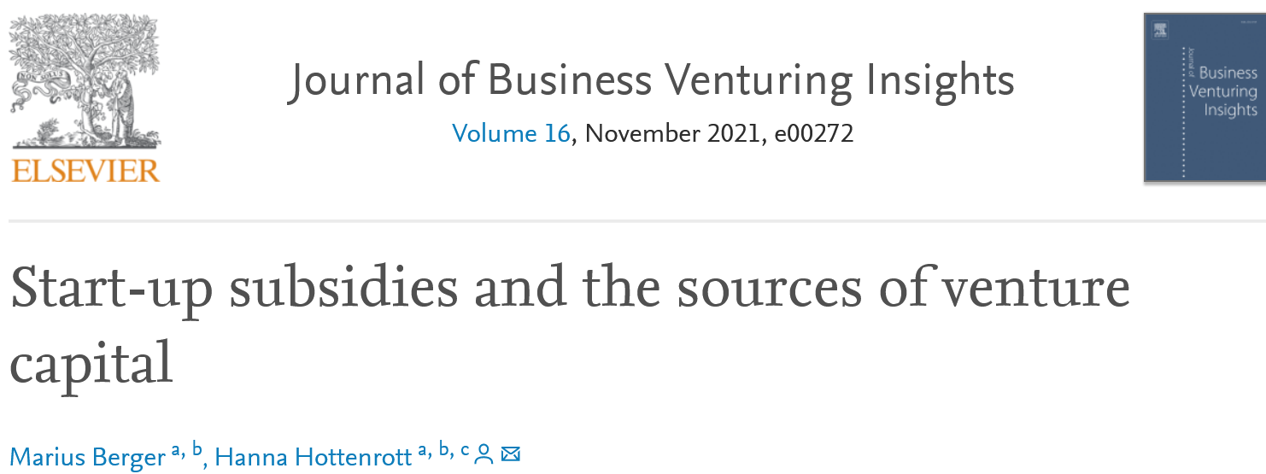
Solution?
Econometric methods for causal interference in non-experimental settings
Example implementations based on two recent articles
Opportunities
Limitations

Slide 7
Research design
We cannot observe how a start-up would performed in absence of the subsidy
But:
We can try to estimate the counter factual situation
to get an approximation of the treatment effect based on difference between the treated firms’ outcomes and the counterfactuals

Slide 8
Which method to pick?
Depends on research setting & available data
    Do we know successful and unsuccessful applicants?
    Do we know details about the selection process, e.g. evaluation scores of proposals?
    Do we observe firms before and after the receipt?
In our case
    No information about application process or selection
    No information about rejected applicants
    In many cases, we do not observe the firms before the subsidy
Regression discontinuity designs (RDD) or Difference-in-Differences (DiD) not implementable
Matching techniques to find suitable counter factuals

Slide 9
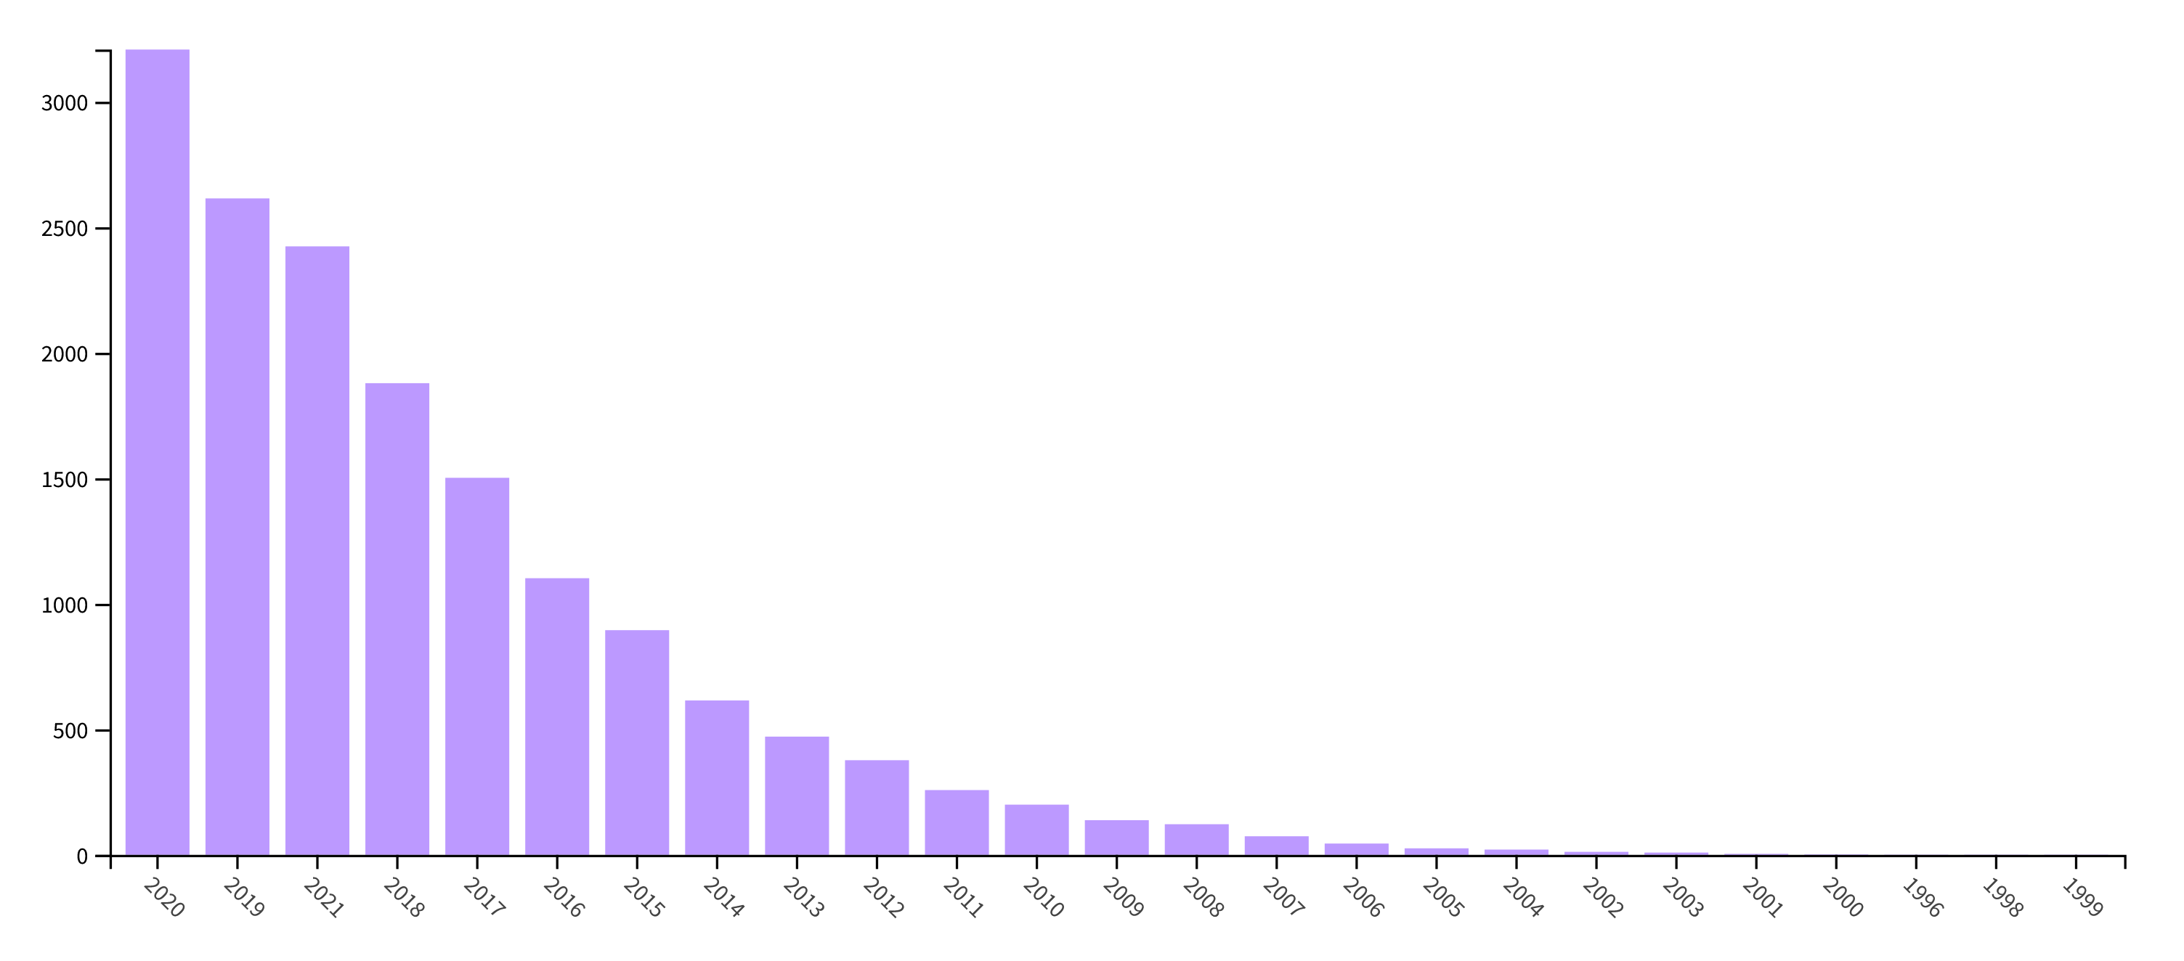
Popularity of Propensity Score Matching (all fields)
Gerfin & Lechner (2002) A microeconometric evaluation of theactive labour market policy in Switzerland, The Economic Journal 112(482), 854–893
Smith &Todd (2005) Does matching overcome LaLonde’s critique of nonexperimental estimators? Journal of Econometrics 125, 305–353
Dehejiaa (2005) Practical propensity score matching: a reply to
Smith and Todd, Journal of Econometrics 125 (2005) 355–364
Imbens & Wooldridge (2009) Recent developments in the econometrics of program evaluation, Journal of Economic Literature 47, 5–86

Slide 10
Research method: Propensity Score Matching
Minimum data requirements:
      Comprehensive data with ideally some time-series properties
          Recipients and non-recipients
          Founder (team) and firm characteristics
Here:
      Founding cohorts 2005-2012 (IAB/ZEW Start-up Panel)
      Information on receipt of subsidy
      Information on relevant performance outcomes: employees, turnover, R&D spending, investment, innovation success
      Information on relevant founder and firm characteristics (Lechner, M., Wunsch, C., 2013. Sensitivity of matching-based program evaluations to the availability of control variables. Labour Econ. 21, 111–121)

Slide 11



Idea
Pick for each treated the most similar un-treated firm
Treatment group S = 1
Founders: Dr. Andreas Sichert, Dr.-Ing. Andreas Schuster, Richard Aumann
Year: 2008
Activity: waste heat recovery
Founders: Dr. Andre Lodwig, Dr. Hans Oswald
Year: 2007
Activity: audiological diagnostics
Control group S = 0
Founders: Daniel Quinger, Dr. Michael Geppert, Tobias Mayer
Year: 2008
Activity: energy storage applications
Founders: Dr. Joachim Wiest, Prof. Dr. Bernhard Wolf, Dr. Helmut Herz, Herbert Zuleger
Year: 2007
Activity: system solutions for microphysiometry
Gründer: Dr. Joachim Wiest, Prof. Dr. Bernhard Wolf, Dr. Helmut Herz, Herbert Zuleger
Gründungsjahr: 2007
Notes:
Orcan: waste heat recovery
Path: audiological diagnostics
Lion: energy storage applications

Slide 12
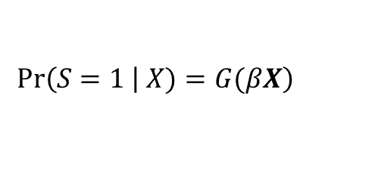
Propensity Score Matching
Collect attributes that predict treatment
Founder(s)‘ academic background, age, industry experience, entrepreneurial experience, professional experience, team (composition, e.g. gender, academic background), enture age, revenue, profit, ex-ante financing structure, patents, market penetration (e.g. export), R&D activity, capacity utilization, location characteristics
Estimate propensity to receive treatment
Calculate the Mahalanobis distance between a treated and a control observation (Gerfin & Lechner 2002)
For each treated firm pick closest neighbor(s) (Rosenbaum and Rubin, 1983)
$$\left.Pr\left(S=1 \right| X)=G(βX\right)$$

Slide 13
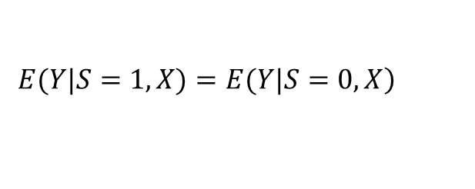
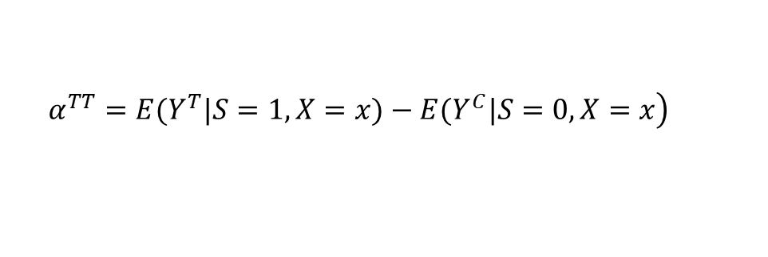
Propensity Score Matching
Employ a caliper to avoid “bad matches” by imposing a threshold of the maximum distance allowed
    Why? Closest neighbor could still be relatively far away, i.e. not similar enough
Combine with exact matching (founding cohort, sector, region)
    Why? Some comparisons may simply not be reasonable
    PSM reduces complexity by matching on a single score, but this has drawbacks compared to (Coarsened) Exact Matching
Conditional independence assumption (Rubin 1977):
Estimate the average treatment effect as:
$$\left.E(Y|S=1,X)=E(Y|S=0,X\right)$$
$$\left.α^{TT}=E(Y^{T}|S=1,X=x)−E(Y^{C}|S=0,X=x\right)$$

Slide 14
The data

Slide 15
Characteristics before matching
 | Potential Control Group |  |  | Treatment Group
 | N= 4,057 |  |  | N= 822
Variables | Mean | SD |  | Mean | SD | t-test*
Founder characteristics
University | 0.332 | 0.471 |  | 0.341 | 0.474 | 0.623
Vocational training | 0.190 | 0.392 |  | 0.178 | 0.382 | 0.415
Master craftsman | 0.221 | 0.415 |  | 0.210 | 0.408 | 0.502
Founder age | 44.746 | 10.079 |  | 44.797 | 9.211 | 0.893
Industry experience | 17.239 | 9.660 |  | 16.591 | 9.021 | 0.076
Entrepreneurial experience | 0.458 | 0.498 |  | 0.416 | 0.493 | 0.029
Bankruptcy experience | 0.072 | 0.258 |  | 0.071 | 0.256 | 0.886
Opportunity driven | 0.779 | 0.415 |  | 0.755 | 0.430 | 0.138
Female | 0.128 | 0.334 |  | 0.108 | 0.311 | 0.120
 | Potential Control Group |  |  | Treatment Group
 | N= 4,057 |  |  | N= 822
Variables | Mean | SD |  | Mean | SD | t-test*
Firm characteristics
Team | 0.374 | 0.484 |  | 0.384 | 0.487 | 0.589
Start-up age_{t-1} | 2.796 | 1.655 |  | 2.331 | 1.524 | 0.000
Limited liability | 0.520 | 0.500 |  | 0.557 | 0.497 | 0.051
ln(Tangible assets) | 5.814 | 4.468 |  | 5.733 | 4.551 | 0.634
Patent stock | 0.183 | 3.672 |  | 0.130 | 1.586 | 0.688
Export activity_{t-1} | 0.151 | 0.358 |  | 0.212 | 0.409 | 0.000
Capacity utilization_{t-1} | 84.988 | 29.852 |  | 88.104 | 28.668 | 0.006
East Germany location | 0.131 | 0.338 |  | 0.210 | 0.408 | 0.000
ln(R&D-Expenditure)_{t-1} | 1.832 | 3.946 |  | 2.714 | 4.676 | 0.000
ln(Employees)_{t-1} | 0.865 | 0.753 |  | 0.833 | 0.934 | 0.284
ln(Revenue)_{t-1} | 7.695 | 5.620 |  | 6.451 | 5.973 | 0.000
ln(Tangible Investment)_{t-1} | 5.471 | 4.817 |  | 5.017 | 5.052 | 0.015
Profit_{t-1} | 17.724 | 105.303 |  | 6.123 | 94.865 | 0.003

Slide 16
Outcomes before matching
 | Potential Control Group |  |  |  | Treatment Group
Variables | Mean |  | SD |  | Mean | SD | t-test*
(R&D-Exp/ Employees)_{t+1} |  | 402 | 1,029 |  | 494 | 1,173 | 0.023
(R&D-Emp/ Employees)_{t+1} |  | 11.200 | 26.318 |  | 15.003 | 28.326 | 0.000
ln(R&D-Expenditure)_{t+1} |  | 3.208 | 4.835 |  | 4.178 | 5.277 | 0.000
ln(R&D-Employees)_{t+1} |  | 0.220 | 0.482 |  | 0.347 | 0.596 | 0.000
ln(Employees)_{t+1} |  | 1.340 | 0.637 |  | 1.504 | 0.746 | 0.000
ln(Revenue)_{t+1} |  | 11.035 | 3.559 |  | 11.260 | 3.534 | 0.098
ln(Tangible Investment)_{t+1} |  | 6.254 | 4.606 |  | 7.001 | 4.441 | 0.000

Slide 17
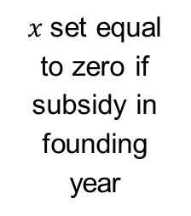

Plausible timing?
$x$set equal to zero if subsidy in founding year
Immediate effect on inputs
Longer run effects on events and performance
t₋₁
t
subsidy year
t₊₁
t_{+n}
time-variant founder & venture characteristics
R&D activities
Investment
Employment
Innovation
Revenue
Employment
Merger
Acquisition
Venture Capital
Bankruptcy
$\operatorname{Pr}\left(S=1 \right|X=x$)
with S = grant
Notes:
Folie erklären lassen.

Slide 18
Propensity Score Estimation
Pr(treatment)
Several of the predictors explain subsidy receipt
→ Significant differences between treated and untreated firms that could also explain differences in performance
Notes:
Folie erklären lassen.

Slide 19
Matching outcome
Propensity score & all covariates should be balanced after matching!
Notes:
Was ist auf Y Achse?

Slide 20
Propensity Score Estimation (after matching)
Pr(treatment)
Notes:
Was ist der Unterschied zur Folie 10

Slide 21
Results

Slide 22
Outcomes after matching
 |  | Selected Control Group |  |  | Treatment Group
 |  | N= 732 |  |  | N= 732
Outcome variables |  | Mean | SD |  | Mean | SD | t-test of mean difference
(R&D-Exp/ Employees)_{t+1} |  | 465.111 | 1,070.221 |  | 464.538 | 1,118.555 | 0.992
(R&D-Emp/ Employees)_{t+1} |  | 11.738 | 26.208 |  | 14.028 | 27.890 | 0.106
ln(R&D-Expenditure)_{t+1} |  | 3.624 | 4.979 |  | 3.800 | 5.124 | 0.506
ln(R&D-Employees) _{t+1} |  | 0.236 | 0.511 |  | 0.299 | 0.543 | 0.024
ln(Employees)_{t+1} |  | 1.349 | 0.640 |  | 1.428 | 0.700 | 0.026
ln(Revenue)_{t+1} |  | 10.791 | 4.019 |  | 11.132 | 3.546 | 0.085
ln(Tangible Investment) _{t+1} |  | 5.995 | 4.672 |  | 6.916 | 4.403 | 0.000
Before matching:
ln(Employees)_{t+1} |  | 1.340 | 0.637 |  | 1.504 | 0.746 | 0.000

Slide 23
Conclusions
Opportunities
Limitations

Slide 24
Strengths and pitfalls I
Differences between groups in post treatment outcome variables can be causally attributed to the subsidy
if we assume that we observe all relevant differences between treated and untreated firms
Propensity score matching → simple method to reduce selection bias
Key advantages:
    Modest data requirements
    Quasi-randomization
    Simplifies matching on many characteristics → single score
Points to remember when using matching methods
Critically reflect the results
    Not only propensity score should be balanced after matching, but also all predictors
    If not the case: combine with caliper and/or exact matching
What unobservable factors may be important (but are not proxied for)?

Slide 25
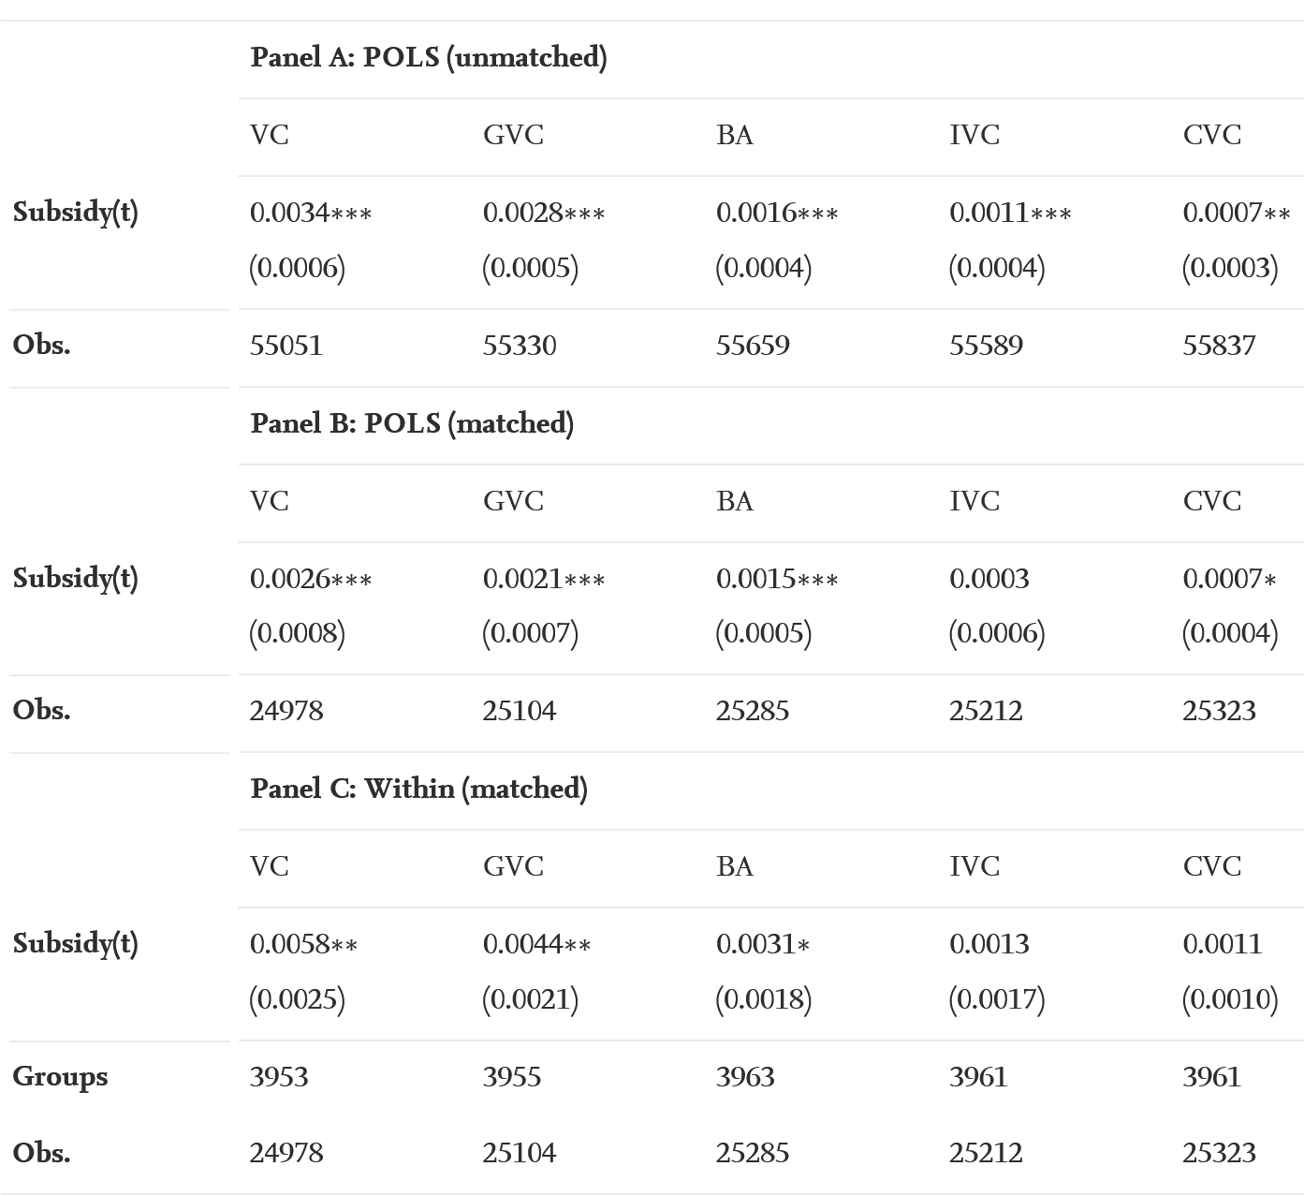
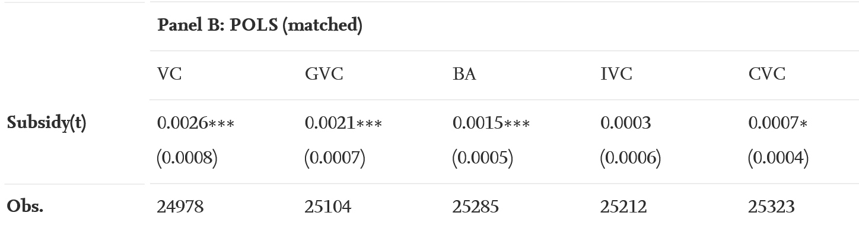
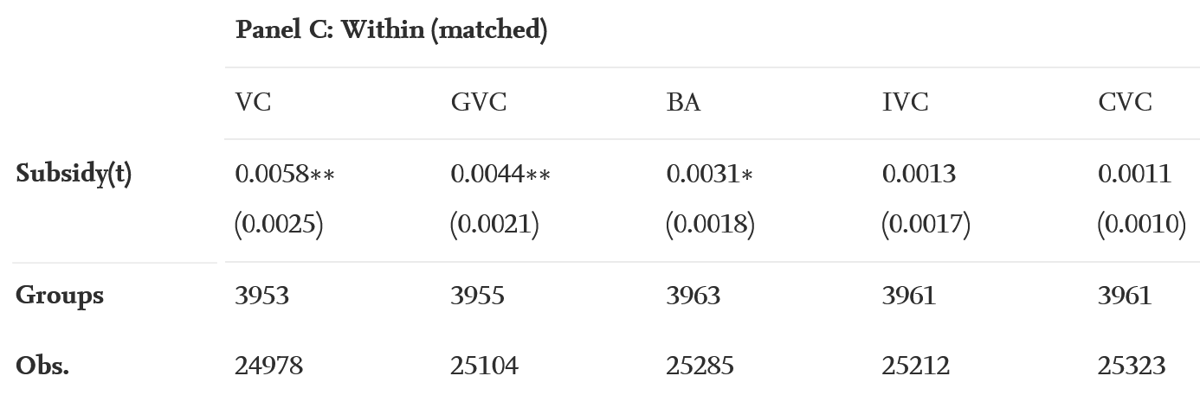
Addressing “matching on observables problem”
Combine PSM with fixed effects models (Arkhangeslky & Imbens 2018, The role of the propensity score in fixed effect models, NBER Working Paper #24814)
Question here:
Are start-up subsidies causally linked to follow-on financing?
Captures influence of time-constant unobservables

Slide 26
Strengths and pitfalls II
What other external factors could affect the result? Are there other “treatments“ happening?
How plausible is the timing?
How sensitive is the size of treatment effect to the given sample?
    How plausible is the effect size? How meaningful is the average treatment effect?
    What about treated firms that were not “matched”?
    Discrete versus continuous treatment
How sensitive are the results to using different matching approaches:
    E.g. Coarsened Exact Matching or Kernel matching (see e.g. Todd P.E. (2010) Matching Estimators. In: Durlauf S.N., Blume L.E. (eds) Microeconometrics. The New Palgrave Economics Collection)
Methods for continuous treatments → generalized propensity scores (see e.g. Imbens 2000, The role of the propensity score in estimating dose-response functions, Biometrika, 87(3), 706–710)

Slide 27
Thank you!

Slide 28
Contact details
Professor Dr. Hanna Hottenrott
Professorship Economics of Innovation
Technical University of Munich
TUM School of Management
Arcisstrasse 21
80333 Munich
hanna.hottenrott@tum.de
www.professors.wi.tum.de/eoi

