Slide 1
Innovation and RD data and the use of it - the Danish case
Jens Storm
Head of Division, Analysis and data

Slide 2
Agenda
Impact assessments – innovation programmes
The data and access to it..
Current focus – R&D data (better quality data and easier use)
The Danish experience / the Danish advice

Slide 3
Impact assessments – innovation programmes
Framework for doing impact assessments: Central Innovations Manual
Important to choose the performance indicators in the design of the program and sticking to the indicators during the assessment process
Notes:
CIM!: https://ufm.dk/publikationer/2011/filer-2011/cim-excellente-effektmaalinger.pdf
Important to stress the need to have some ground rules/methods that a far as possiple is the same across assessments of the different instrustruments. We used to have these principles stated in the CIM-manual, which served as a handbook for collecting the relevant data, for doing the assessment and for which indicators serving as a performance indicators (and thereby the success of the given instrument.
2) The need to plan the evaluation/assessement of a given instrument/program already in the planning process cannot be stressed enough! It is a natural aspect of the design process and it will help with the nesseary supplement datacollection during the instrument-period.
BUT! The participents in the workshop already knows this!

Slide 4
Impact assessments
Econometric impact assessments of innovations programs
Data from Statistics Denmark from the whole company population + possibly survey data from the treated population
Choosing the appropriate comparison group using either the “nearest neighbour”, ”propensity score matching” or diff-in-diff methods
Notes:
Using state-of-the-art research methods in the process of impact assessments
And not only the treated population → meaning that we can do a total comparison of the intervention (aka the participation in a given innovation program) – in the cases where it is not possible to asses the treatetment using only the data from statistics Denmark an assessment will be supplemented with a survey
A quick-listing of the favorite methods of assessing innovation programs ☺

Slide 5
The data and access to it
UFM register beneficiaries of public innovation grants in a central database
The information on beneficiaries can be uploaded to Statistics Denmark and in a pseudonymizatied form be accessed for econometric analysis

Slide 6
Statistics Denmark I
Firm statistics at Statistics Denmark is a full population record-based statistics based on records from:
the Danish Tax Agency
the Danish Business Authority
Notes:
Tax record informations: turnover, profit, number of employees etc.
ERST: information on Organisation type, locations (regions), ownershipstructure etc.
The list above is not complete (but the most important ones)

Slide 7
Data – Statistics Denmark II
Researchers at a Danish research institute or Ministry can get access to pseudonymizatied data at Statistics Denmark
The access to data is through a VPN connection and in a closed research environment
Since 1999 it is not a requirement for the researcher to be on-site at Statistics Denmark but can get a remote access by her own computer

Slide 8
Statistics Denmark III
Research access
Ministry access
Projected based access
Need-to-know basis
Research approach
The possibility to upload own data to the research environment
Permanent access
Nice-to-know basis
Policy approach incl. ad hoc answers
The possibility to upload own data to the research environment
Notes:
There is two different kinds of remote access to data
Jens, jeg tænker at du godt kan free-style lidt om de 2 forskellige adgange

Slide 9
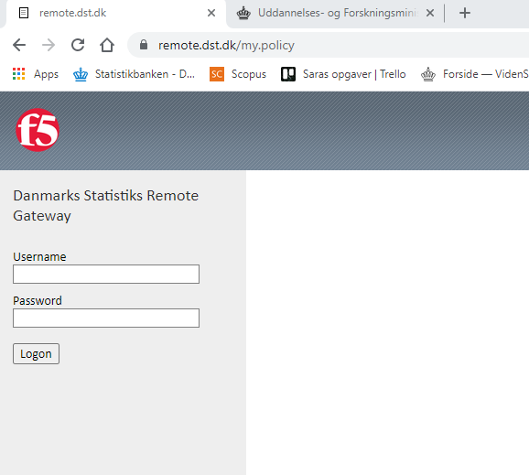
Statistics Denmark IV
Easy and remote access to data
Via. VPN connection
Different entries for different individuals
The possibility to do econometrics quick and ”easy”
Notes:
Jens! Det her er mit skrivebord hos DST. Bemærk, jeg har så mange forskellige adgange, da de ikke ”forsvinder” selvom man skifter arbejdssted.

Slide 10
Statistics Denmark V
Strict rules on publication of results!
A breach of these rules leads to strict (and possible permanent) sanctions for both the researcher and the institution
Research institutions and Ministries pay for access to data
Notes:
Sara – følg lige op på hvad ordningen koster!

Slide 11
Data on innovation activities in private firms
Survey executed by Statistics Denmark (European Innovation Scoreboard)
Approximately 1.100 random selected companies (out of a population of 9.000)
Data collected every other year
Access to micro-data through Statistics Denmark
Notes:
Statistics Denmark is collecting data in order to fulfill the requirement to the European Innovation Scoreboard published by EUROSTAT

Slide 12
The Effect of Multiple Participations in the Danish Innovation ond Research Support System (2016)
Comparing second participation to first time participation in one af ten different programs
Data on beneficiaries (and participation) from UFM
Firm statistics from Statistics Denmark (register data)
Balanced panel
Using a fixed effects diff-in-diff estimation

Slide 13
The Effect of Multiple Participations in the Danish Innovation ond Research Support System (2016)
3.379 in the treated group and 162.597 in the control group
The treated group with second participation was small!
The measured effect was Total Factor Productivity growth
No immediately significant effects on TFP growth by second or first time participation.
Significant effects detected for the largest programs
Notes:
The significant effect was found for Innovation Network, Innovation Voucher, Innovation Assistant and Innovation Consortia
https://ufm.dk/publikationer/2016/filer/the-effect-of-multiple-participations-in-the-danish-innovation-and-research-support-system.pdf

Slide 14
Current focus – R&D data (better quality data and easier use)
A new approach for collecting data in UFM
Data collected from the public research funds under UFM using their administrative records on both application and grants
Data on scientific publications submitted by Danish researchers
Information on personnel employed at one of the 8 Danish universities
Notes:
This is the implementation of a strategic initiative establising data of high quality and consistency. In Denmark relevant data on applications and grants, academic personal and careers and not least reaserch outputs is contained in different mangement systems. This data establishing program seeks to operationalize alle these data source bringing them on a common form.
The goal is to end up in place where we can execute outcome driven analysis of research funding among other things and thus creating an evidence based platform servicing the descision making proces.

Slide 15
R&D data at UFM
Clusters
(14)
Independent Research Fund Denmark
E-grant
R&D database
Innovation Fund Denmark
Publications
(NORA)
The Danish National Research Foundation
ISOLA
Personnel
Notes:
At the core of the core of the data establishing program in the area research, development and innovation is three databases consisting of
Funding applications and grants
Academic personel
Danish research outputs

Slide 16
The Danish experience / the Danish advice
High quality evaluations are an important part of program continuation decisions
High quality data are becoming more and more important
Widespread (and cheap) access to data are an important prerequisite for a lot of work in the field
Notes:
Sara – følg lige op på hvad ordningen koster!

Slide 17
Questions?
Jens Storm
JST@UFM.dk

